Slide 1

E-commerce Price Optimization using DNN
Aman Dhumal – 21107036
Meet Jamsutkar – 22207004
Varad Joshi – 21107002
Rohan Waghode – 21107008
Project Guide
Ms. Poonam Pangarkar
Notes:
1

Slide 2
Outline
Introduction
Literature Survey of the existing systems
Limitations of the existing systems
Problem statement
System Design
Technologies and methodologies
Implementation
Conclusion
References
Notes:
2

Slide 3
Introduction
Recommendation engines are indispensable tools in the digital era, leveraging advanced algorithms to enhance user experiences by predicting preferences and offering tailored suggestions.
Category play a crucial role in refining recommendation processes, enabling categorization and aligning content with user interests.
Pricing strategies in ecommerce are evolving, focusing on agility, data-driven decisions, and real-time adaptation to meet consumer demands.
An innovative application aims to transform traditional pricing strategies by considering factors like product ratings, inventory dynamics, and market trends to optimize customer value.
This application focuses on products and categories where price adjustments can significantly impact customer decisions, such as perishable products and services.
Notes:
3

Slide 4
Literature Survey of the existing system
“Recommendation Systems: Principles, Methods, and Evaluation" [1] provides a comprehensive examination of recommendation systems, highlighting their pivotal role in improving user experiences across e-commerce and content streaming platforms.
“Content-Based Filtering for Recommendation Systems Using Multiattribute Networks” [2] presents a novel approach utilizing multiattribute networks to address information overload in recommendation systems. Empirical findings demonstrate significant enhancement in recommendation accuracy with this methodology.
"Learning similarity with cosine similarity ensemble" [3], the authors introduce an ensemble technique tailored to enhancing similarity assessments, with a specific focus on the widely used cosine similarity measure.
“Dehak et al.'s 2010” research [4] delves into cosine similarity scoring without the need for score normalization, particularly in the context of speech and language processing.
“Study of demand models and price optimization performance”- Georgia Institute of Technology, December 2011 : The price optimization engine aims to dynamically adjust product prices in real time based on multifaceted factors such as consumer demand, product shelf life, inventory levels, and market prices to maximize conversions and provide the best value to customers.
Notes:
4

Slide 5
Limitations of existing systems
Traditional collaborative filtering methods struggle when dealing with new users or items lacking sufficient data, resulting in poor recommendations until enough interactions are collected.
Many recommendation algorithms tend to recommend items similar to those a user has already interacted with, potentially causing a lack of diversity and serendipity in recommendations.
In scenarios where the number of users and items is large, the available data may be sparse, leading to challenges in accurately capturing user preferences and item similarities.
Systems often recommend popular items more frequently, neglecting niche or less-known items, which can lead to homogenized recommendations and overlook user-specific preferences.
Deep learning-based approaches, such as Neural Collaborative Filtering, may provide accurate recommendations but lack interpretability, making it challenging to understand why certain recommendations are made.
Notes:
5

Slide 6
Problem statement
The aim to transform the way pricing strategies are traditionally devised and employed within the ecommerce industry.
Sellers need to know the best pricing to be set for a product or service to nudge conversions on the buyer applications end. The price(s) should be valid for a limited duration.
At its core, the application should be agile, intuitive, and data-driven, with the ability to swiftly adapt prices in real time. It should include a multifaceted array of factors, including but not limited to the ever-shifting demands of consumers, the nuanced dynamics of product shelf life, and the real-time status of inventory levels.
Focus on products and categories where there is a margin for a cost change that impacts the customer ( Example: Perishable products, Services).
In the application, customers check for pricing received from the various seller platforms to get the best value for their purchase based on factors such as Inventory, Terms of Trade, Margins, Strategic Call, time of the day, and current market prices.

Slide 7
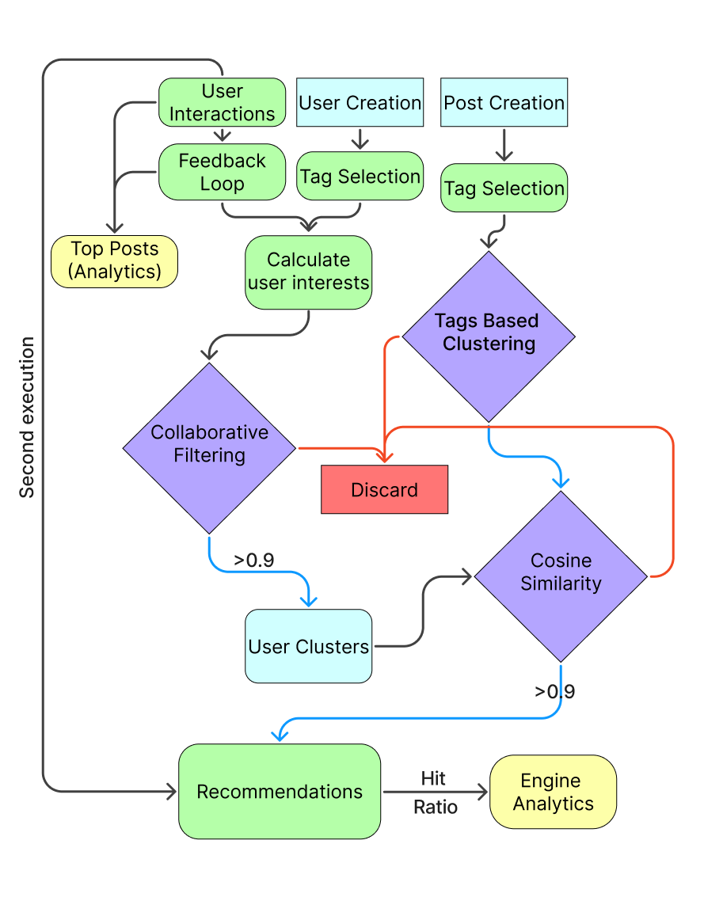
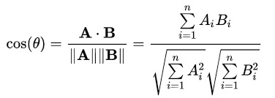
System Design
Notes:
7

Slide 8
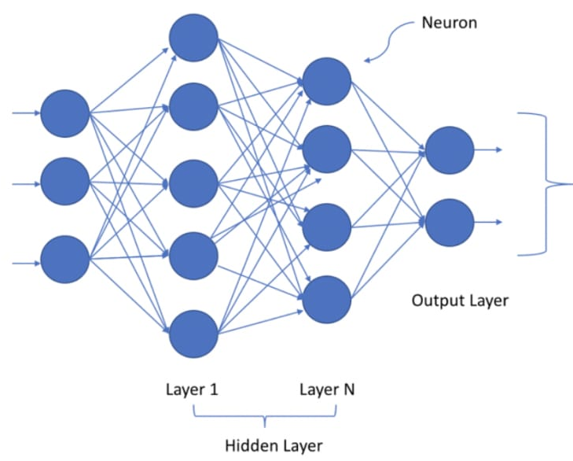
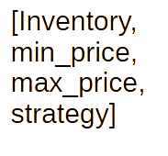
Prize Optimization
Optmised_price
(real-time discount_price)
Notes:
8

Slide 9
Technologies and methodologies
Python 3.12.0
Django 5.1
SQLite 3.45
Tailwind CSS v3.0
Tensorflow 2.15.0
Google Cloud Platform(GCP)
Deep Neural Networks(DNN)
Notes:
9

Slide 10
Conclusion
Through this research, we have learned the importance of adaptability in recommendation systems.
User preferences are dynamic, and our system's ability to continuously update and refine recommendations in response to evolving interests is a crucial feature. We have also gained insights into the significance of user feedback in reducing recommendation errors and enhancing prediction accuracy.
Additionally, exploring more advanced machine learning techniques and considering real-time user interactions could refine our recommendation engine even further.
In summary, our research has illuminated the path to a recommendation engine that not only adapts to users' changing preferences but also actively engages them in the improvement process. By leveraging the lessons learned and exploring future enhancements, we can continue to elevate the user experience and deliver increasingly accurate and relevant recommendations.
Notes:
10

Slide 11
References
1) Isinkaye, Folasade Olubusola, Yetunde O. Folajimi, and Bolande Adefowoke Ojokoh. "Recommendation systems: Principles, methods and evaluation." _Egyptian informatics journal_ 16.3 (2015): 261-273.
2) Son, Jieun, and Seoung Bum Kim. "Content-based filtering for recommendation systems using multiattribute networks." _Expert Systems with Applications_ 89 (2017): 404-412
3) Xia, Peipei, Li Zhang, and Fanzhang Li. "Learning similarity with cosine similarity ensemble." _Information sciences_ 307 (2015): 39-52.
Dehak, Najim, et al. "Cosine similarity scoring without score normalization techniques." _Odyssey_. 2010.
“Study of demand models and price optimization performance”- Georgia Institute of Technology, December 2011
Notes:
11

Slide 12
Thank You...!!
Notes:
12

